Slide 1
SEAC at Arcadia
April 26, 2018
Special Education at Arcadia Charter School:
A Brief Overview

Slide 2
What is SEAC?
Advisory
Support
Guidance
Advocate
*Handouts available or visit: http://www.mnseacinfo.org/index.asp

Slide 3
Our Building Staff…
Lisa Malecha – School Social Worker/Special Education Coordinator
Gary Braun – Special Education Teacher (MS*)
Sarah Wallis – Special Education Teacher (MS*)
Tamra Paulson- Special Education Teacher (MS*/HS*)
Alison McCusker – Special Education Teacher (HS*)
Amy Merritt – Special Education Teacher (HS*)
Cindy Graff – Special Education Administrative Assistant
*MS = middle school *HS = high school

Slide 4
Building Staff
Chris Kelley – Paraprofessional/Middle School
Lori Coleman – Paraprofessional/Middle School
Desiree Caballero – Paraprofessional/Middle School
Brenda Canning – Paraprofessional/Middle School
Margaret Colangelo – Paraprofessional/Middle School
Maggie Fessler – Paraprofessional/High School
Terry Petek – Paraprofessional/High School
Sonya Ehmer – Paraprofessional/High School
Stone Davis – Paraprofessional/High School

Slide 5
Contracted/Consulting Staff
Lee-Ann Sanborn – Special Education Director
Sharon Miller – Registered Nurse
Melissa Gonzales – School Psychologist
Shannon Gruidl – Occupational Therapist
Kari Foltz – Speech/Language
Jason Milano – Deaf/Hard of Hearing Teacher

Slide 6
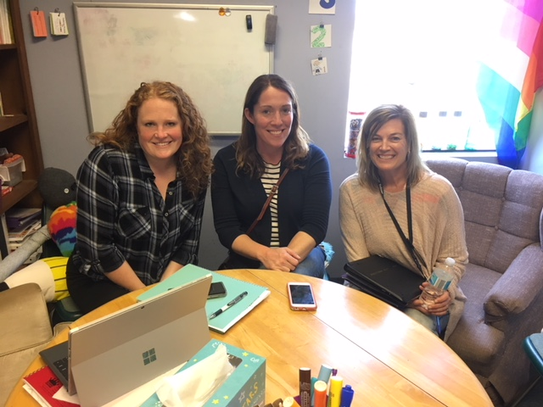
Melissa, Shannon and Kari

Slide 7
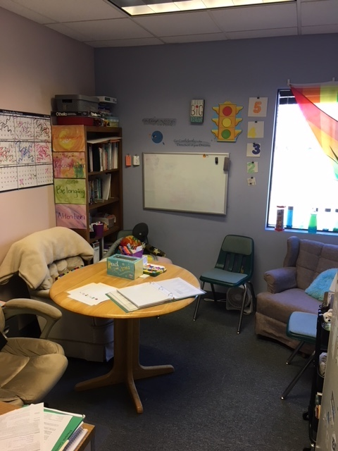
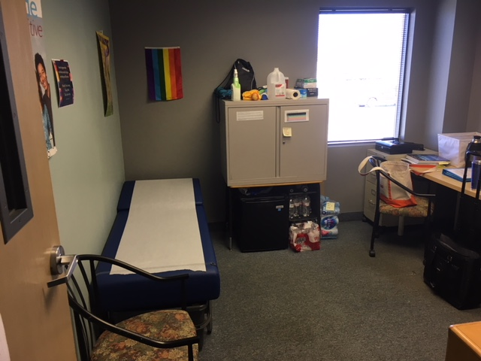
Lisa’s Office & the Health Office

Slide 8
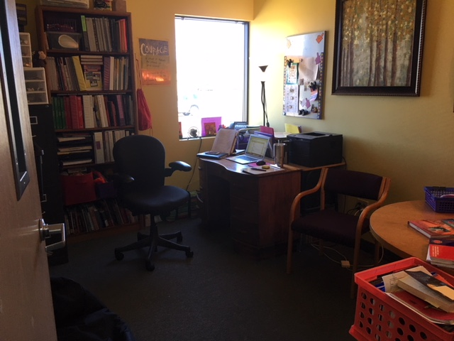
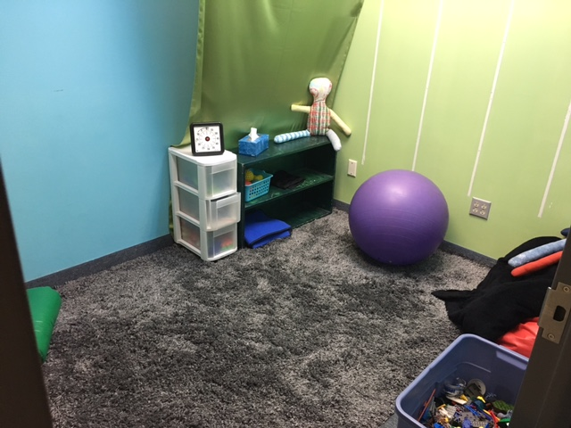
Tamra’s Office & the Sensory Room

Slide 9
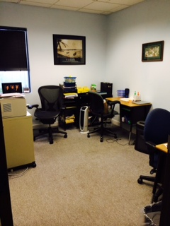
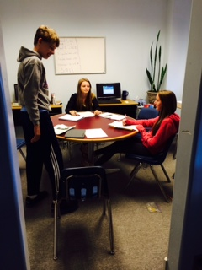
Gary & Sarah’s Office/
Resource Room (MS)

Slide 10
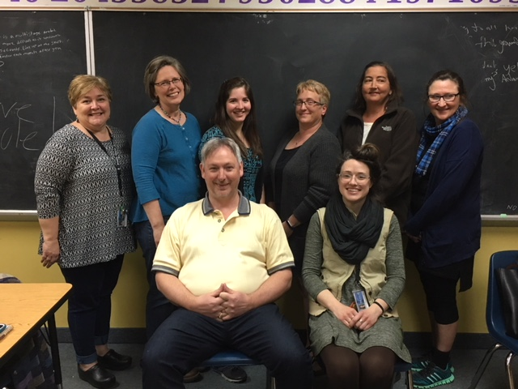
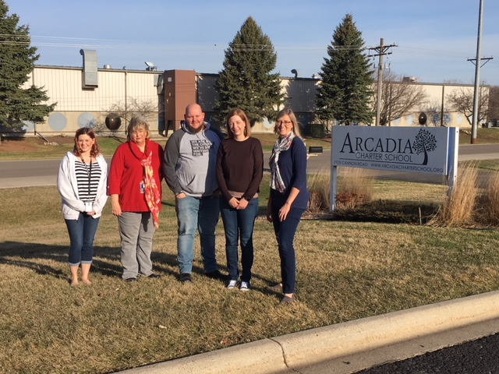
Middle School &
High School Teams

Slide 11
Middle School Program
Direct instruction (pre-teaching and re-teaching) & parallel classes alternative curriculum
OT, speech/language
Push in services – when possible
Social skills instruction, support and direct
Core classes and Project Work Time (guided and structured)
Planning and organizational skills instruction - ABS
Based on individual needs

Slide 12
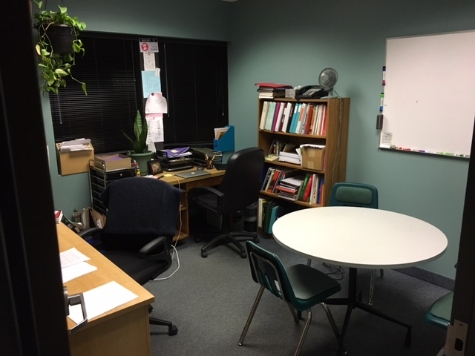
Alison and Amy’s Office

Slide 13
High School Program
Parallel classes (pre-teaching and re-teaching)
Mid level replacement classes (Math & LA)
Push in services
Planning and organizational skills instruction – A Blueprint for Success
Transition planning and programming
Project Work Time, para support & guidance
Based in individual needs

Slide 14
20 staff here weekly to support the needs of our students receiving IEP services
Additional specialists are utilized from time to time – DHH, Behavioral Specialists, Work Force, Vocational Rehabilitation…
This is our 1st year with 5 licensed special education teachers, the school began with 1 – four years ago we added our 3rd

Slide 15
FAPE and LRE
“Children have a right to a free, appropriate education in a setting that is as ‘normal’ as possible. You only remove children from that setting, even part-time, when support or adapted services would be more effective to provide in another way, and the IEP team, which includes parents, makes those decisions,” Norena Hale, state director of special education services for MDE (winter 2004). *PACER handout (PACER.org)

Slide 16
Communication
Advisor (Kate/Jill – Bob/Kim – Angela/Tami – Matt/Scott)
Case Manager (student specific)
Lisa Malecha – Special Education Coordinator
Barb Wornson – School Director
Lee-Ann Sanborn – Special Education Director
Cindy Graff – Special Education Admin Assistant

Slide 17
Other/Next Steps
Monitoring – MN Dept. of Ed. guides our cycle of review, we are in self monitoring this academic year.
Attendance – Kim documents any time away from school.
Regular School Board Meetings – 2nd Thursday of each month at 6:30pm.
Home Districts – tuition billing/programming
Email Kim khansen@arcadiachartershool.org if you need help logging into Engrade and Project Foundry
Parent survey link https://goo.gl/forms/IYZjFjCV0twZDR2M2

Slide 18
Questions & Discussions

